Slide 1
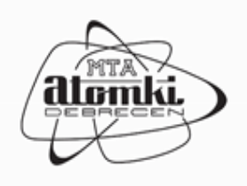

Colombo előtt sem ismert izotópok a vízben
Palcsu László
Izotópklimatológiai és Környezetkutató Központ (IKER)
Magyar Tudományos Akadémia
Atommagkutató Intézet

Slide 2
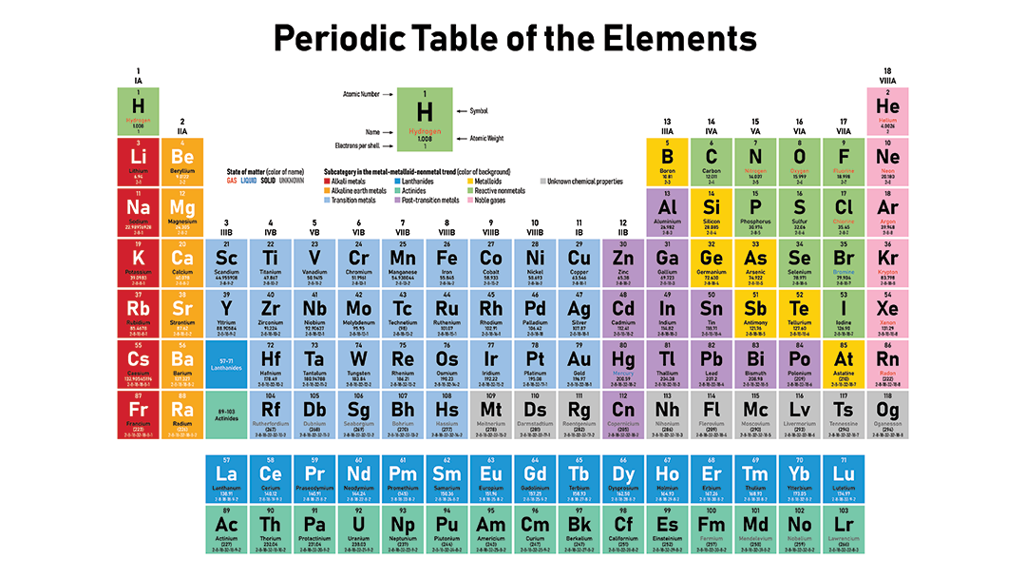
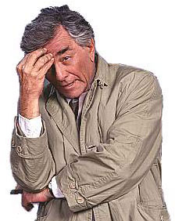
δ^{17,18}O
¹⁴C/¹²C=10⁻¹²
δ^{17,18}O
δ¹⁵N (NO₃⁻,NH₄⁺)
Elemek, izotópok vízben:
³H, δ²H
³H/¹H=10⁻¹⁸
³He/⁴He
He
Ne, Ar, Kr, Xe

Slide 3
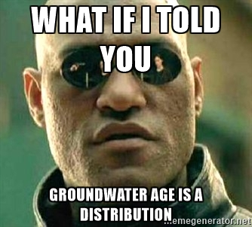
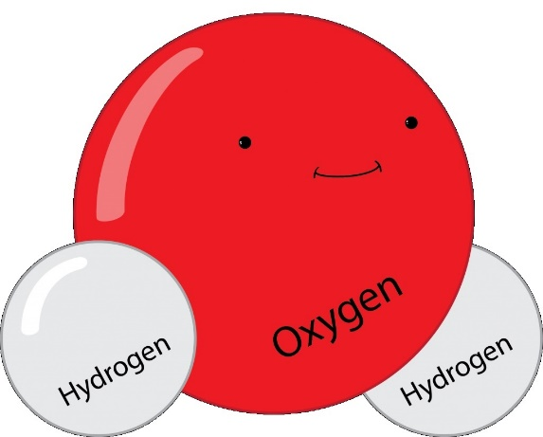
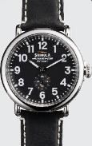
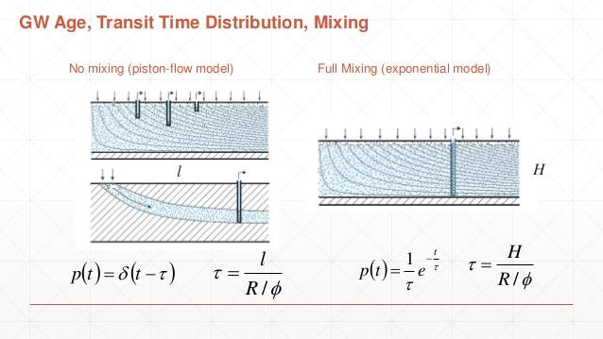
What does (apparent) water age mean ?
What is mean residence time?
What is transit time?
What do we have to mean in age distribution?
What do all these give us?
The point:
The more age indicators we know, the better estimation to the age distribution can be made
Water age is a quantity with a dimension of time, and it helps us estimate the age distribution (end hence other important parameters of the aquifer: volume, mixing patterns, response time, etc.).

Slide 4
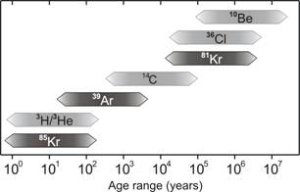

Methods for water age detemination
(time range: 0 to many millions of years)
We WILL perform sampling and krypton separation (measurement by ATTA)
This is what we perform
This is what we WILL perform
This is what we perform
This is what we WILL perform
SF₆ (CFCs?)

Slide 5
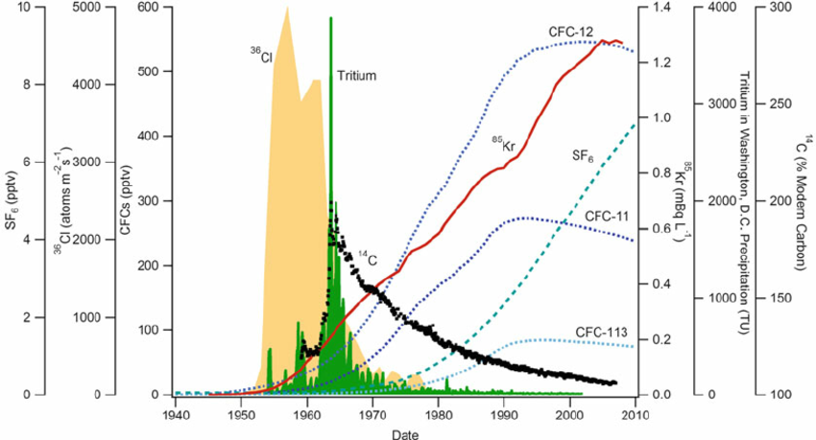
Methods for water age detemination (time range: 0-60 years)

Slide 6
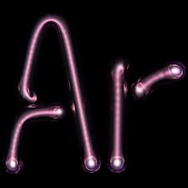
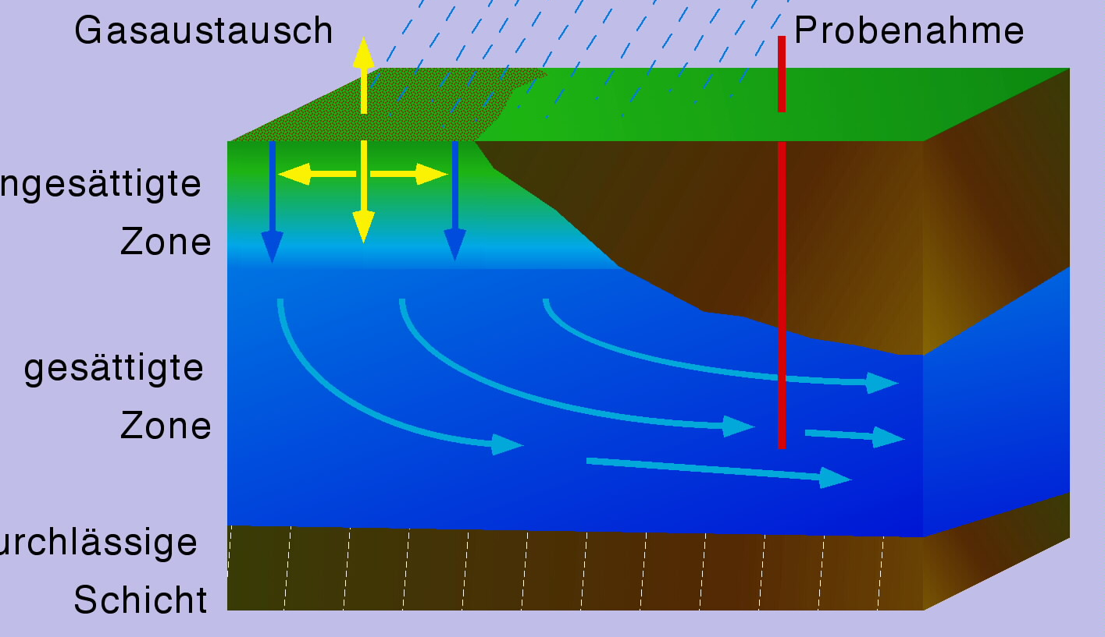
³⁹Ar (argon-39):
Pure beta-decaying isotope
Half-life: 269 years (±3)
Cosmogenic isotope (⁴⁰Ar (n,2n)³⁹Ar)
Activity concentration: ∼1.5 mBq/litre_{Ar} (stable initial concentration over time)
³⁹Ar/Ar ∼ 10⁻¹⁶ (this is the main problem)
gas exchange
sampling well
The only 2 (+1) laboratories:
University of Bern, Switzerland
PNNL, Richland, USA
(ICER, Debrecen, Hungary)
equilibration
unsaturated zone
saturated zone
impermeable layer

Slide 7
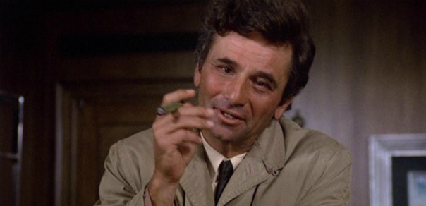
⁸⁵Kr in the atmosphere: from reprocessing plants

Slide 8
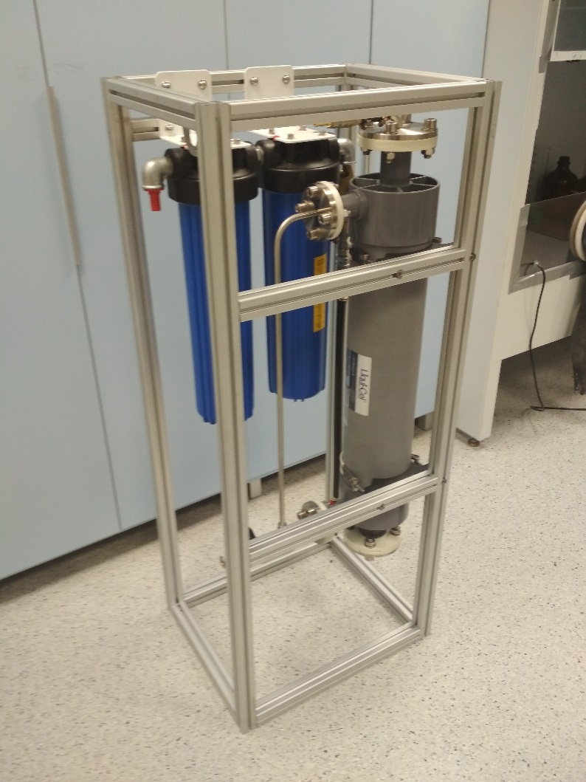
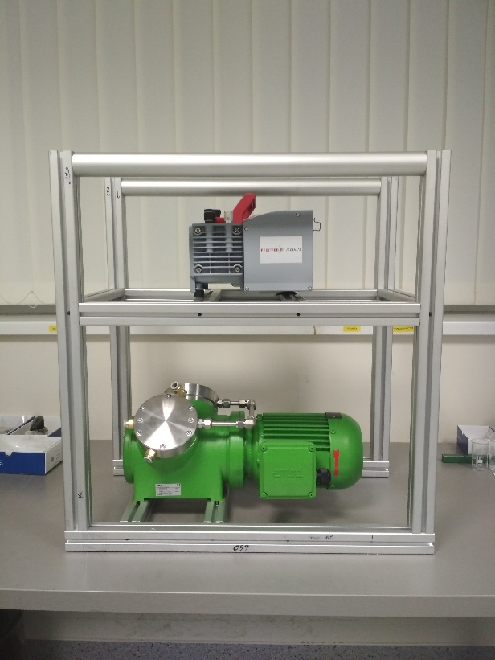
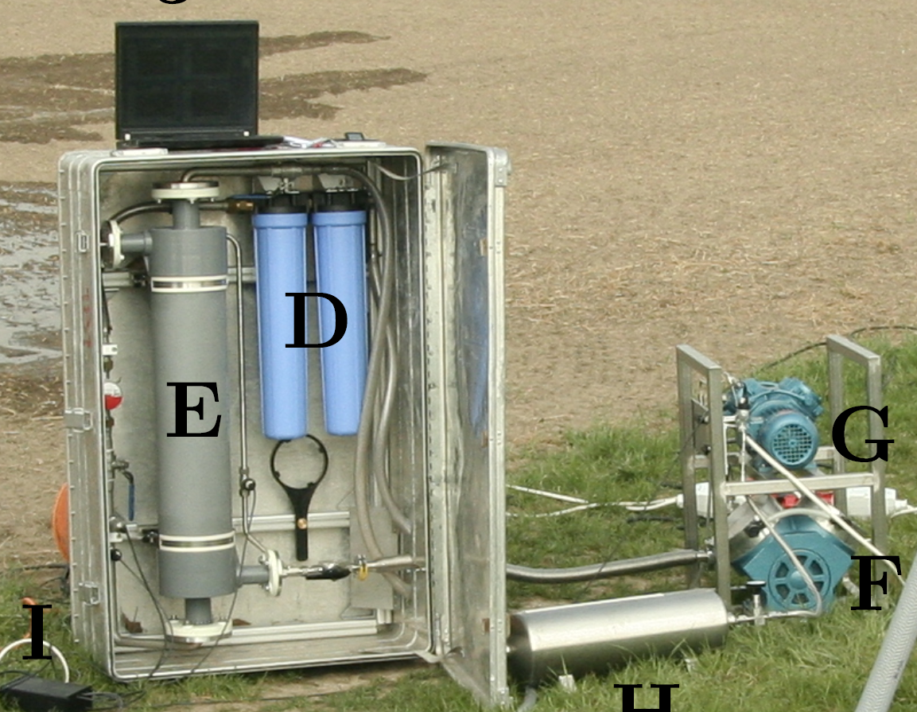
³⁹Ar and ⁸⁵Kr dating of water: sampling in the field:
The aim is to extract at least 100 litres dissolved gas from the water
(and sampling for ⁸¹Kr)
Thomas Reichel PhD dissertation

Slide 9
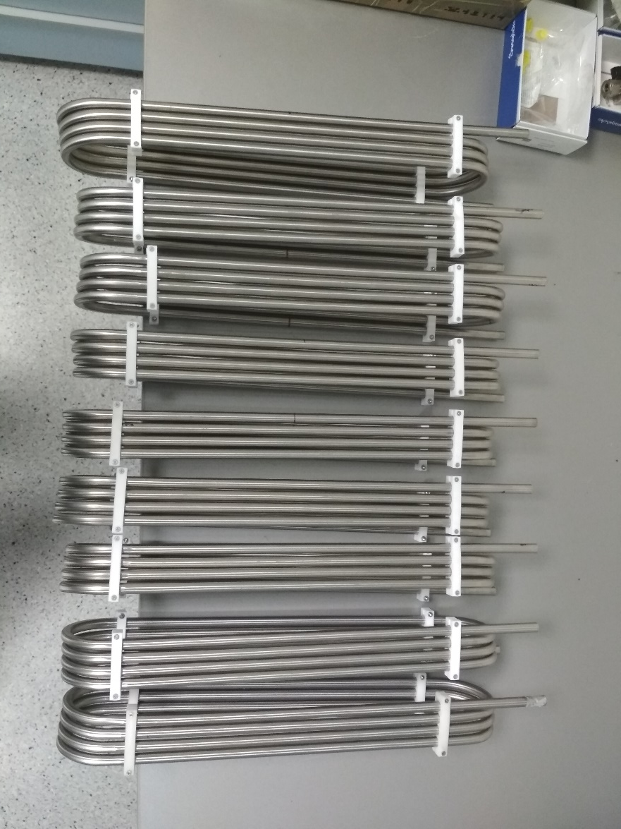
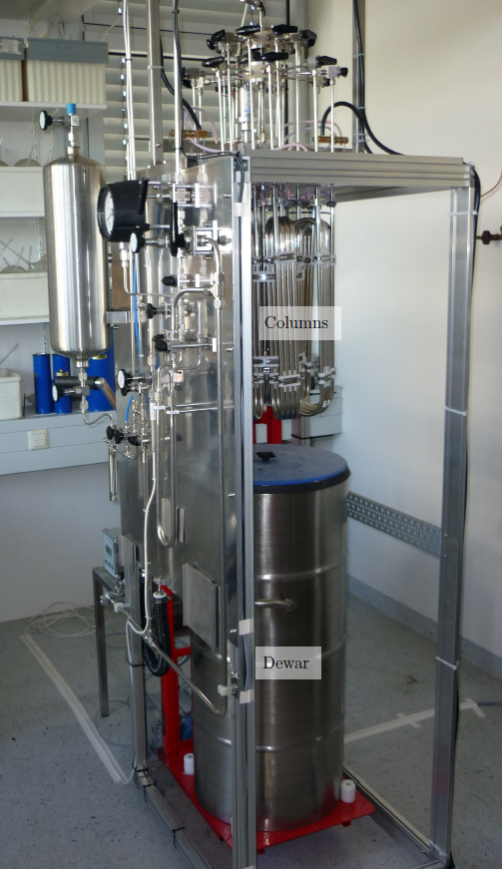
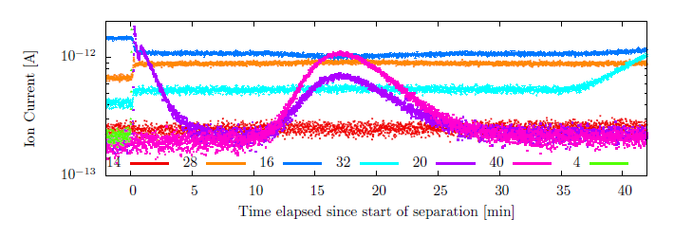
Argon (and krypton) separation: 1 litre of Ar (99.99% purity)!
Cryogenic gas chromatography
Thomas Reichel PhD dissertation

Slide 10
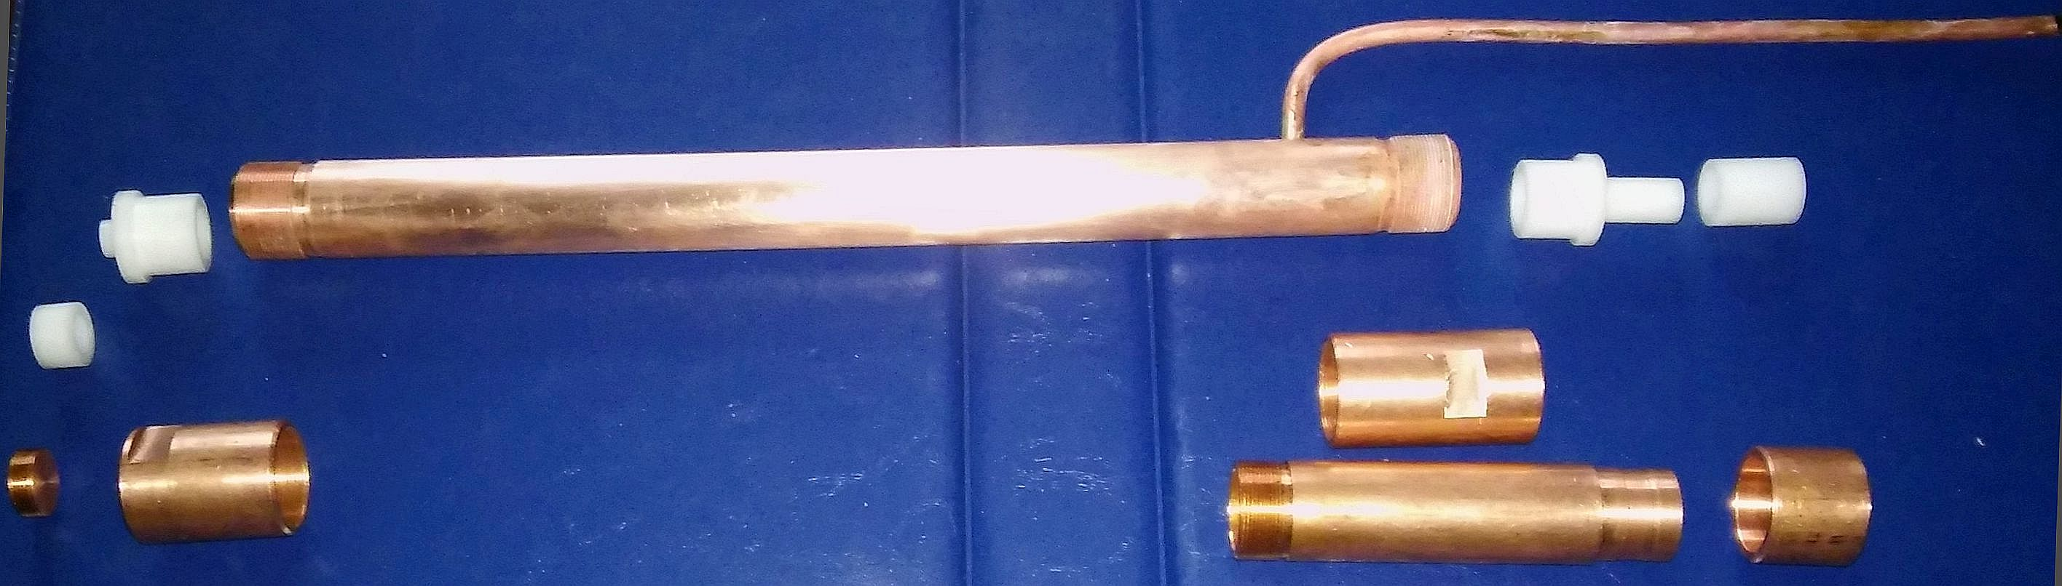
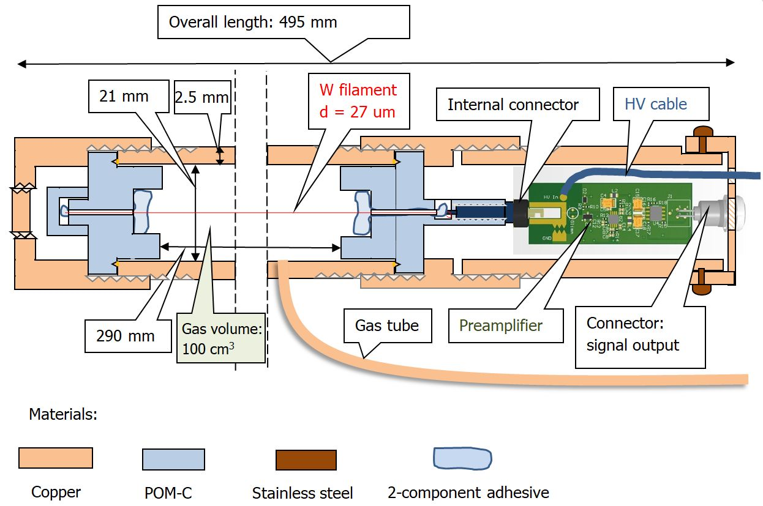
³⁹Ar detection: low background proportional counting tubes
(we choose this)
modern argon: 1.5 mBq/liter!
130 desintegration/day (at least two weeks of detection is necesarry!)
Shielding:
Rock (at least 30 m)
Boronated paraffin (10 cm)
Lead (10 cm)
Copper (1 cm)
Guard counter

Slide 11
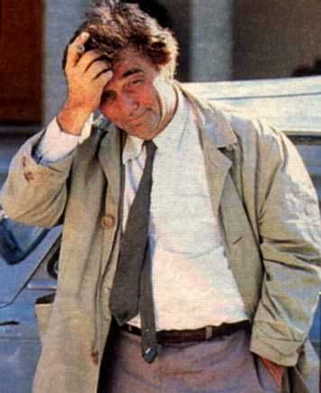
³⁹Ar detection: low background proportional counting tubes
Ar counter gas: 90% argon + 10% methane
Kr counter gas: 20-30 μl krypton + ∼100% methane

Slide 12
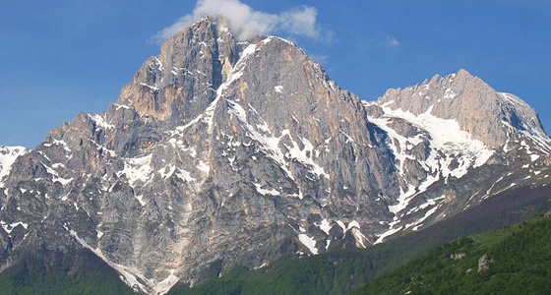
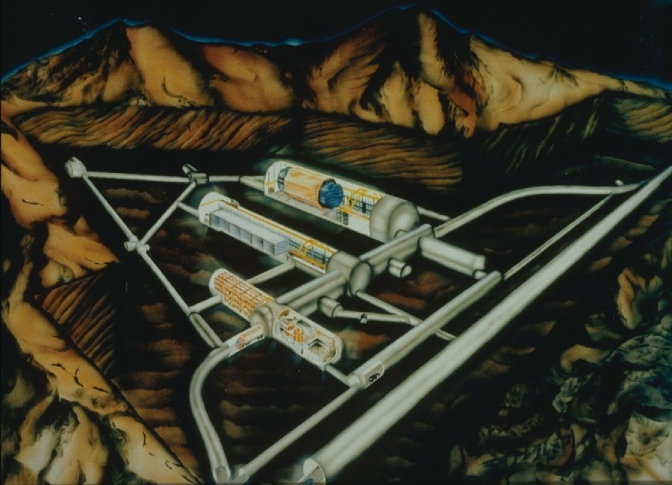
³⁹Ar detection: low background proportional counting tubes
Gran Sasso (Italy)?
A salt mine? A cave or a vine cellar in Hungary?

Slide 13
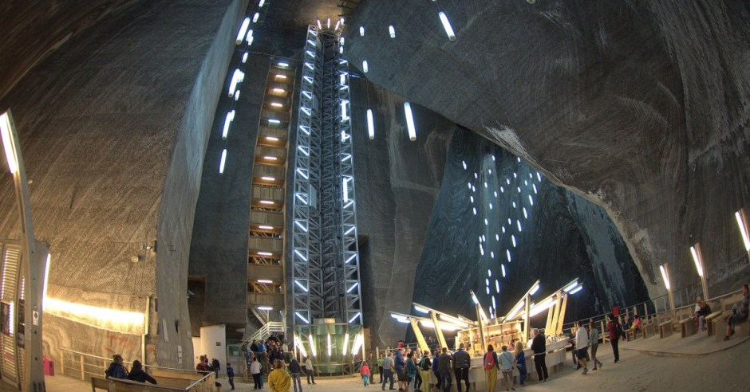
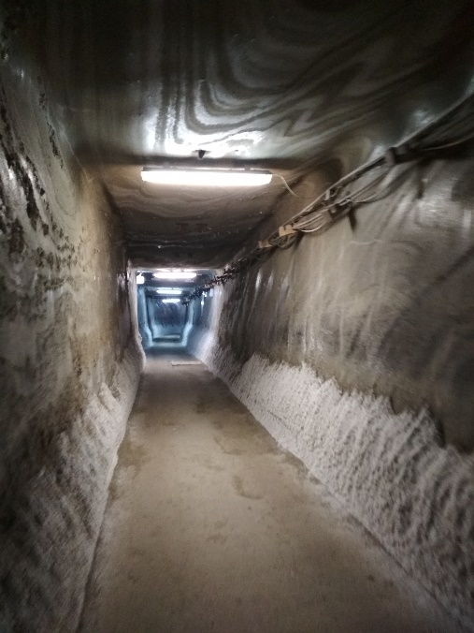
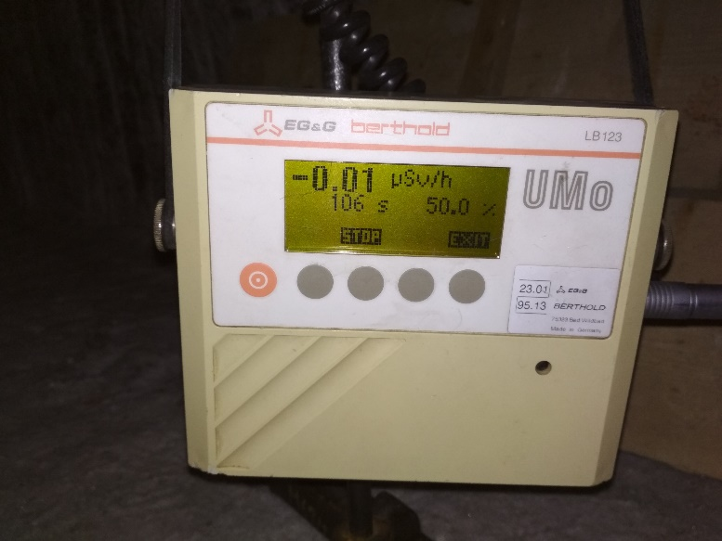
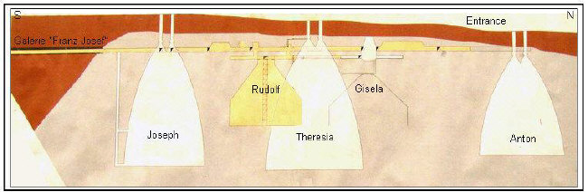
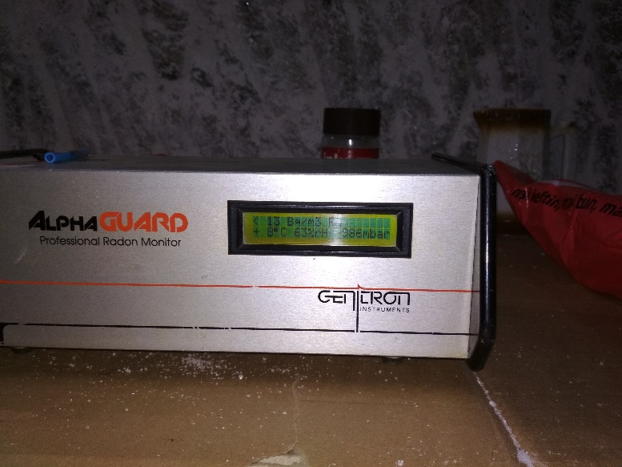
³⁹Ar detection: low background proportional counting tubes
A salt mine? Turda (Romania), Prahova (Romania)?
A vine cellar?

Slide 14
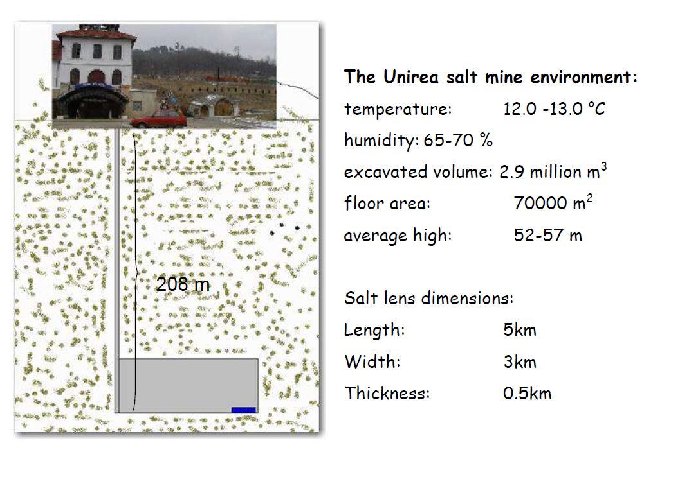
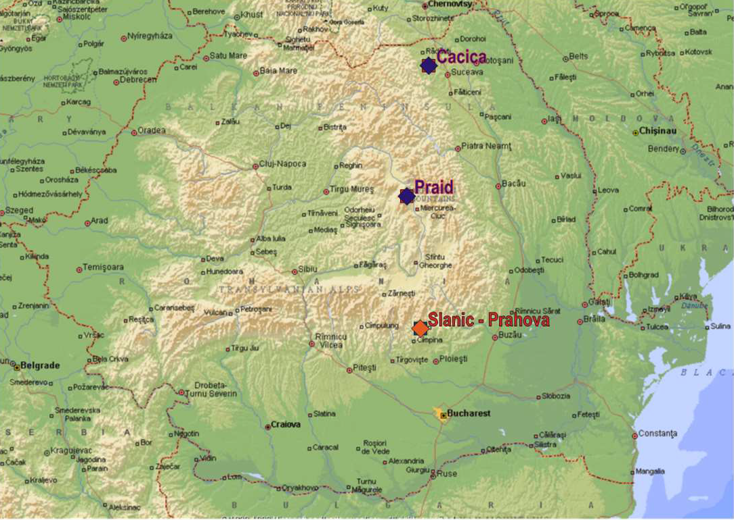
³⁹Ar detection: low background proportional counting tubes
Slanic Prahova

Slide 15
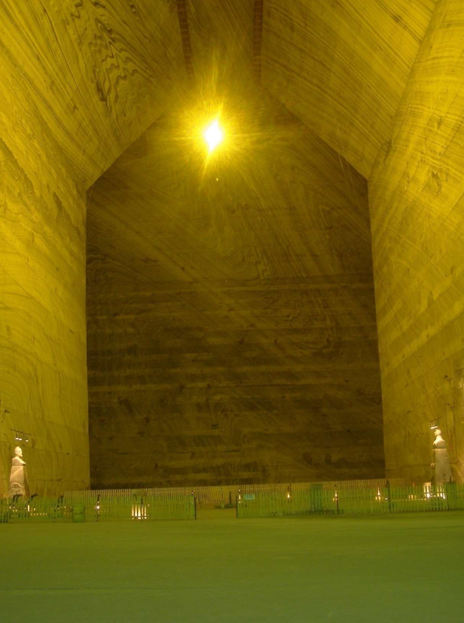
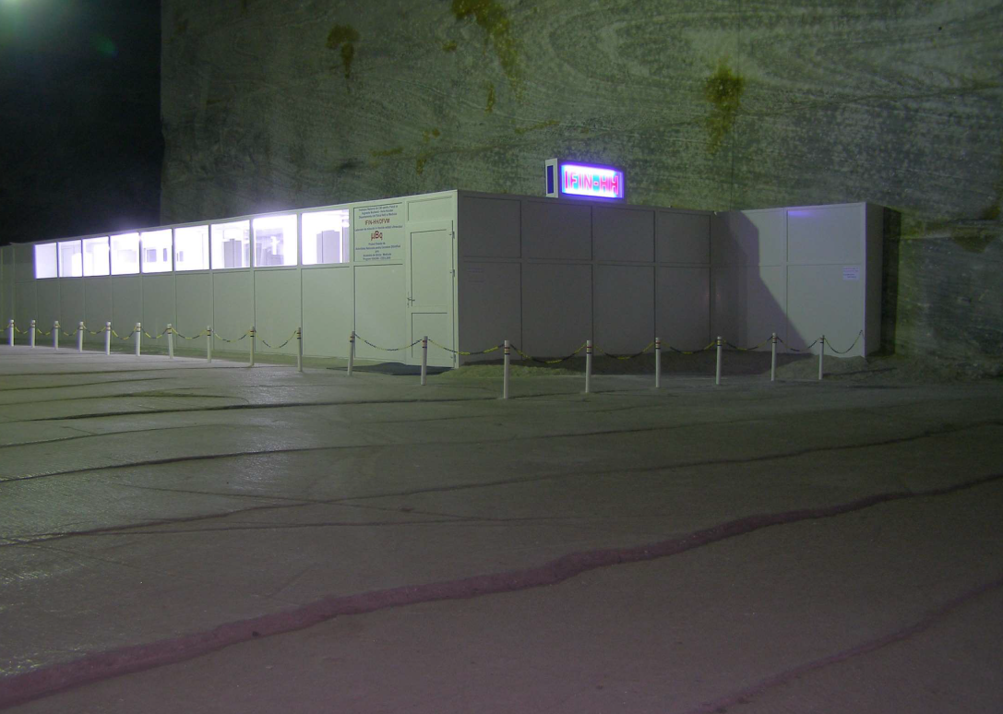
³⁹Ar detection: low background proportional counting tubes
Slanic Prahova

Slide 16
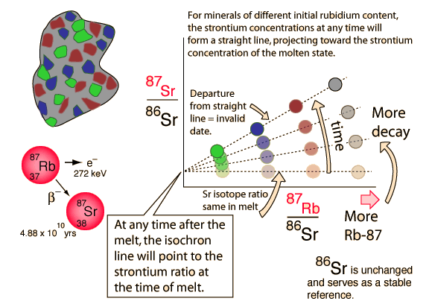
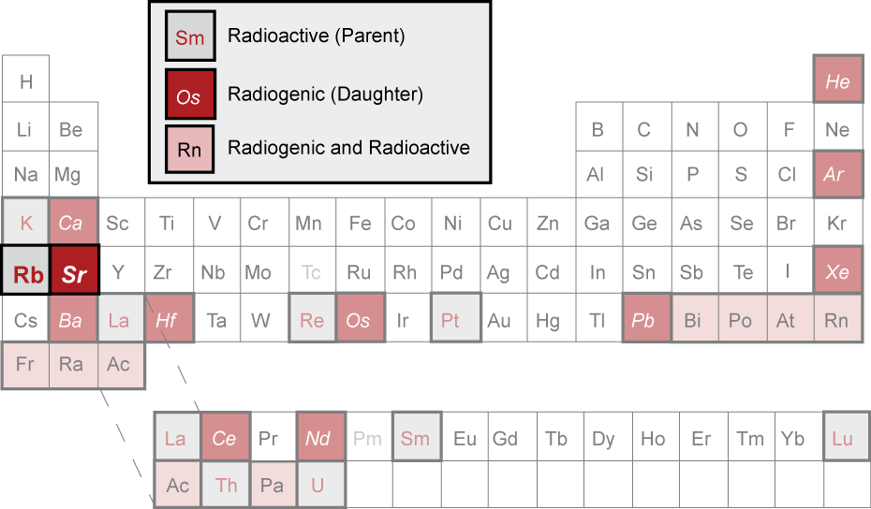
Rb-Sr rendszer
Rb: alkali; soluble, mobile, highly incompatible, substitutes for K
Sr: alkaline Earth; soluble, somewhat mobile, incompatible, substitutes for Ca
Both concentrated in the Earth’s crust; particularly Rb. High Rb/Sr in granitic rocks and their derivatives.

Slide 17
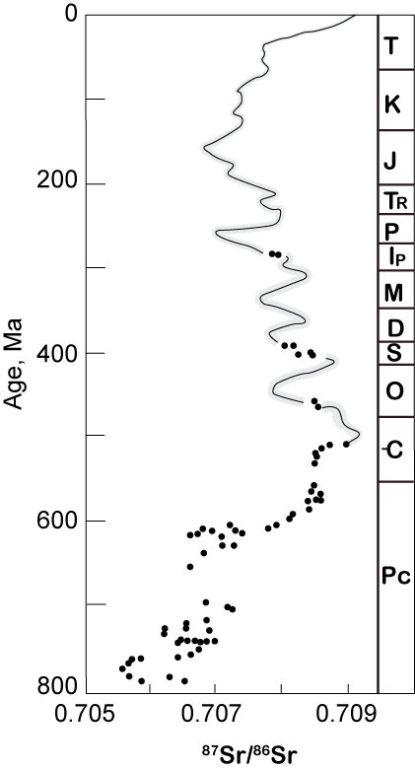
Sr kronoszratigráfia
Sr present in relatively high concentration is seawater.
Also concentrated in carbonates (abundant marine bio-sediment).
Long residence time; therefore
  Sr isotopic composition of open ocean water is uniform (in space).
Sr isotope ratio varies in time, mainly due to changes in the relative fluxes from the continents (erosion) and mantle (ridge-crest hydrothermal activity).
Particularly in the Tertiary, Sr isotope ratio of marine sediment can be used to date the horizon..

Slide 18
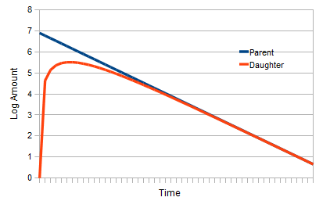
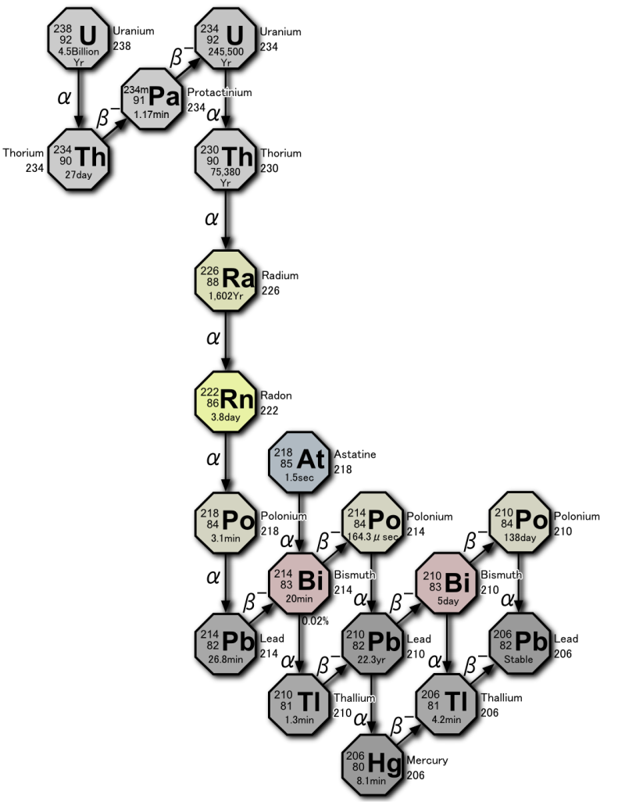
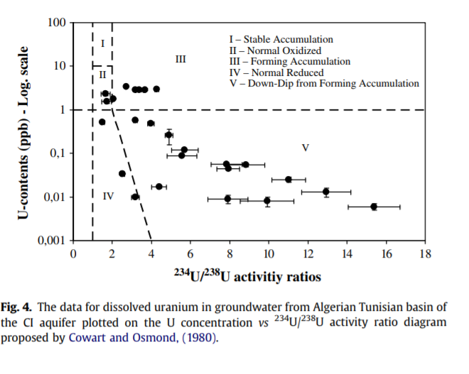
Az urán és bomlási sora

Slide 19
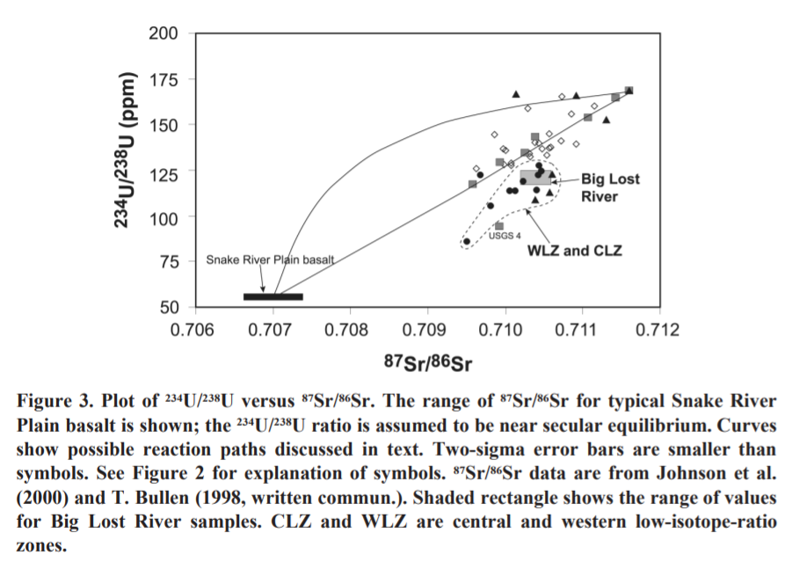
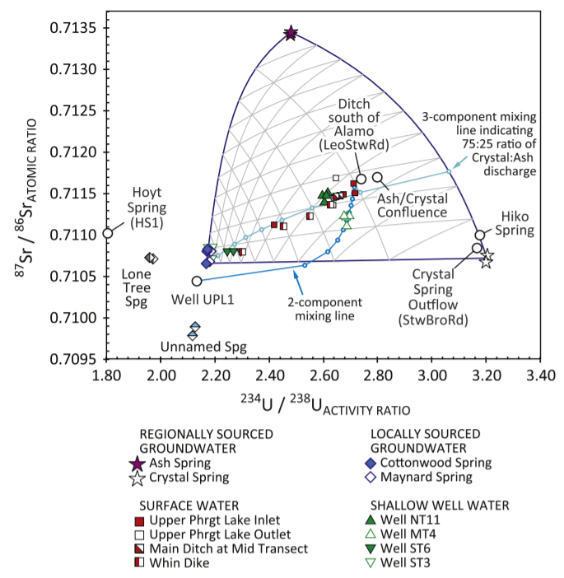
Sr-U izotóparány paramétertér
Figure 2.12

Slide 20
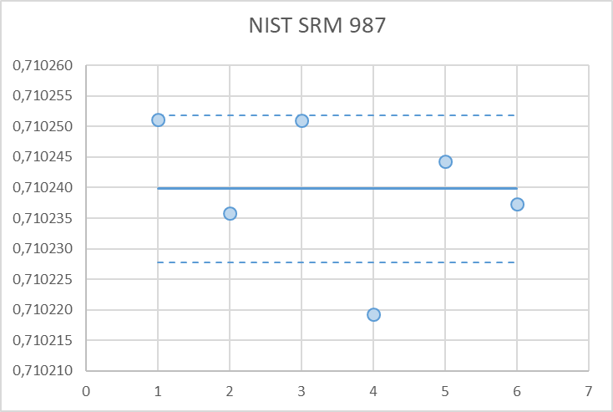
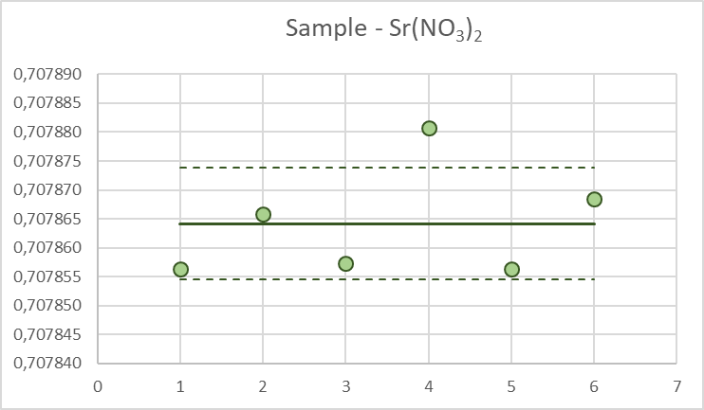
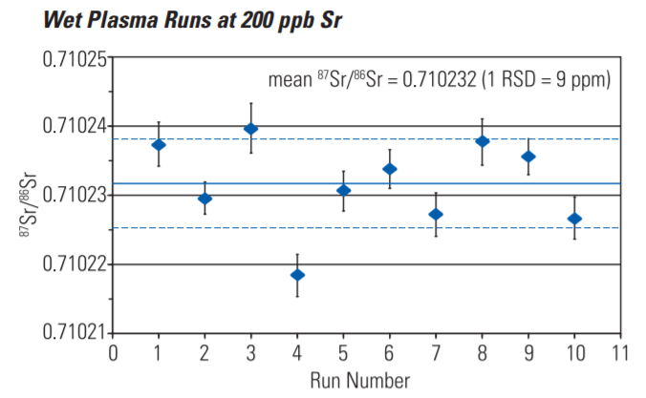
Neptune Plus: multicollector inductively coupled plasma ion source mass spectrometer
Wet plasma 100 ppb ⁸⁷Sr/⁸⁶Sr
Wet plasma 100 ppb ⁸⁷Sr/⁸⁶Sr
17 ppm
14 ppm

Slide 21
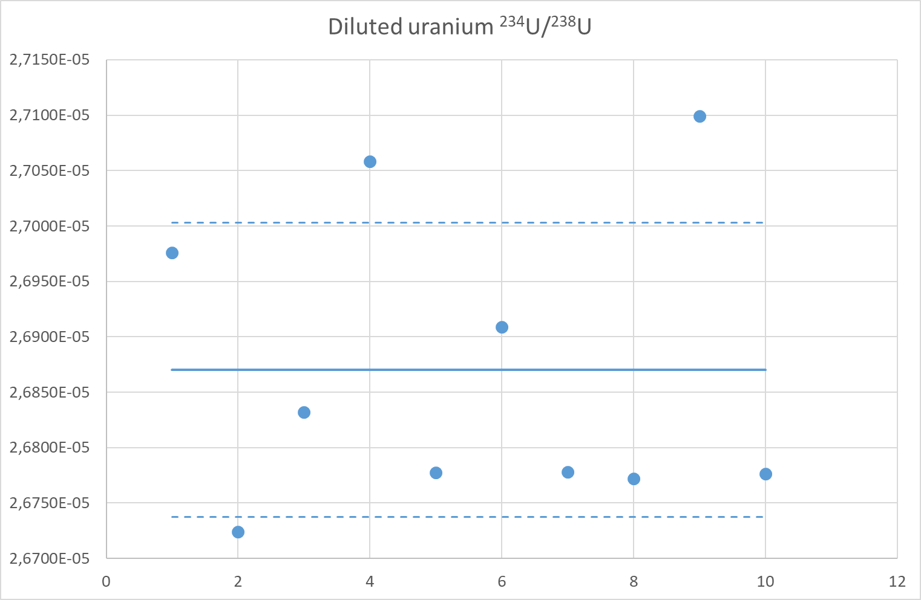
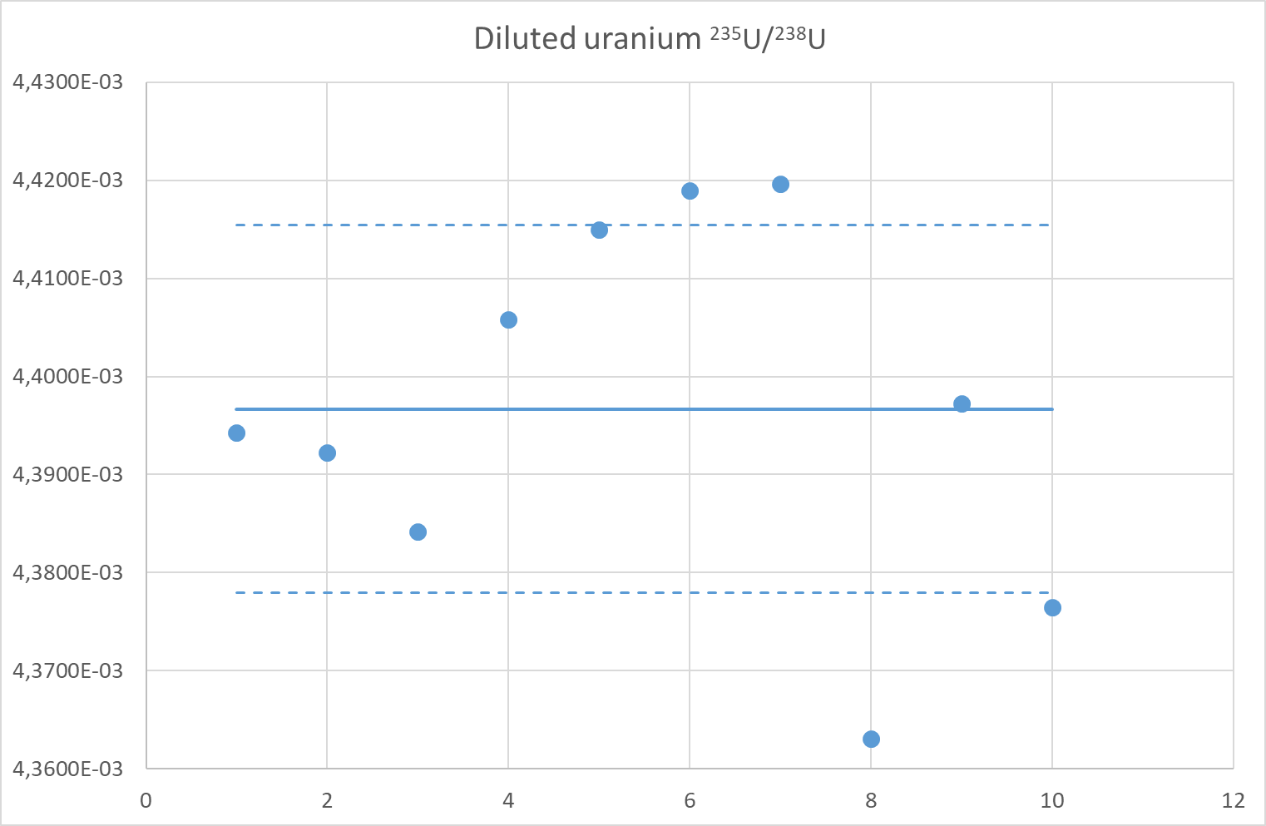
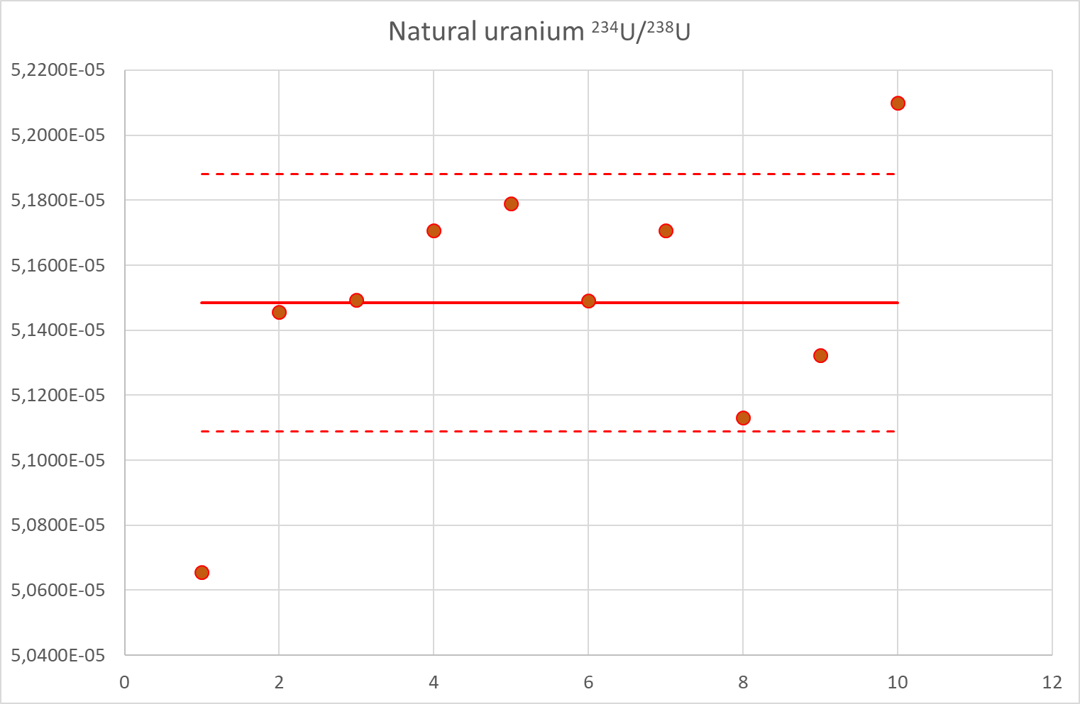
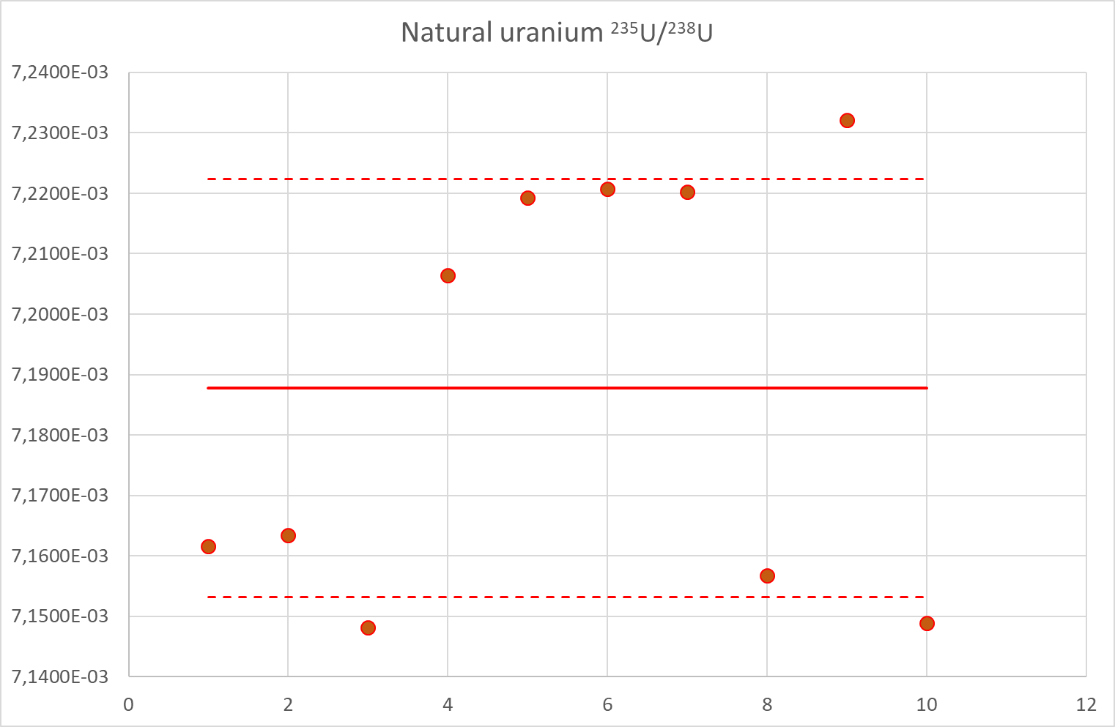
Neptune Plus: multicollector inductively coupled plasma ion source mass spectrometer
0.43 %
0.49 %
0.77 %
0.48 %

Slide 22
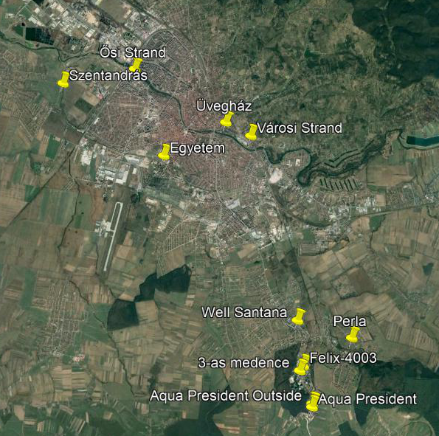
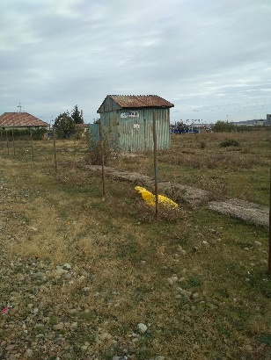
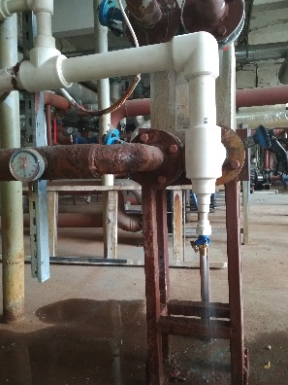










Vízmintavételi helyszínek (ROHU projekt)

Slide 23



Sr-U izotóparány paramétertér

Slide 24
Preparálás 1. (Platzek et al., 2016)
Preparálás 2. (Stoliker et al., 2013)
UTEVA gyanta, előre töltött
100 ppb U oldat (ICP koncentráció std), 15 mL
Gyanta előkezelése: 4 M HNO3, 5 BV (BV=bed volume; 4 mL), majd öblítés UTV-zel, közvetlenül a használat előtt
Kondicionálás: 4 M HNO3, 3 BV
Minta felvitele
Mátrix elúció: 5 BV 4 M HNO3
Minta gyűjtése: 5 mL 0,02 M HNO3/0,0005 M HF
A teszt során 1, ill. 2 mL-es frakciókat szedtünk. Ezeket kétszer bepároltuk tömény HNO3-ban (ultrapure), majd 3 %-os salétromsavban vettük fel.
AG 1x8 anioncserélő gyanta, 2 mL
Kondicionálás: 30 mL 8 M HCl
Minta felvitele: A) 7,5 mL 200 ppb urán oldat a gyantára; B) 7,5 mL 200 ppb urán oldat bepárolva, 3x1 mL cc. sósavval újból bepárolva, majd 1 M HCl-ban felvéve és a gyantára adagolva
Mátrix lemosás: 8 M HCl, 5x3 mL
U eluálás: 1 M HCl, 5x3 mL
Mosás: 5x3 mL UTV
A 2x4 frakciót bepároltuk, 3x1 mL tömény salétromsavban újból pároltuk, majd 3 %-os salétromsavban vettük fel.

Slide 25

Sr (mg/l)
Frakció 2ml-ként, db
SEC - size exclusion chromatography

Slide 26


Sr oszlopkromatográfiás elválasztása,
akár 50ppb koncentrációjú oldatból kiindulva
Sr tartalmazó frakció bepárlása és salétromsavas roncsolása (Ultratiszta 69% HNO3)

Slide 27


Neptune Plus: multicollector inductively coupled plasma ion source mass spectrometer

Slide 28




Neptune Plus: multicollector inductively coupled plasma ion source mass spectrometer

Slide 29

Sampling in South Africa
5-20 Oct 2019

Slide 30

Buffels River Valley
Cape Winelands

Slide 31



Hard work….

Slide 32


Buffels River Valley

Slide 33


….the lowest flow rate

Slide 34



A recharge are in middle-Hungary (³H/³He dating)

Slide 35


Western Cape, South-Africa (³H/³He dating)

Slide 36




Palaeoclimate reconstruction: Great Hungarian Plain, Hungary
9.1 ± 0.8 °C

Slide 37



Kucaj-Beljanica Karst, Serbia
M7000 years!

Slide 38
Methods for water age detemination
(time range: 0 to many millions of years)

